Slide 1
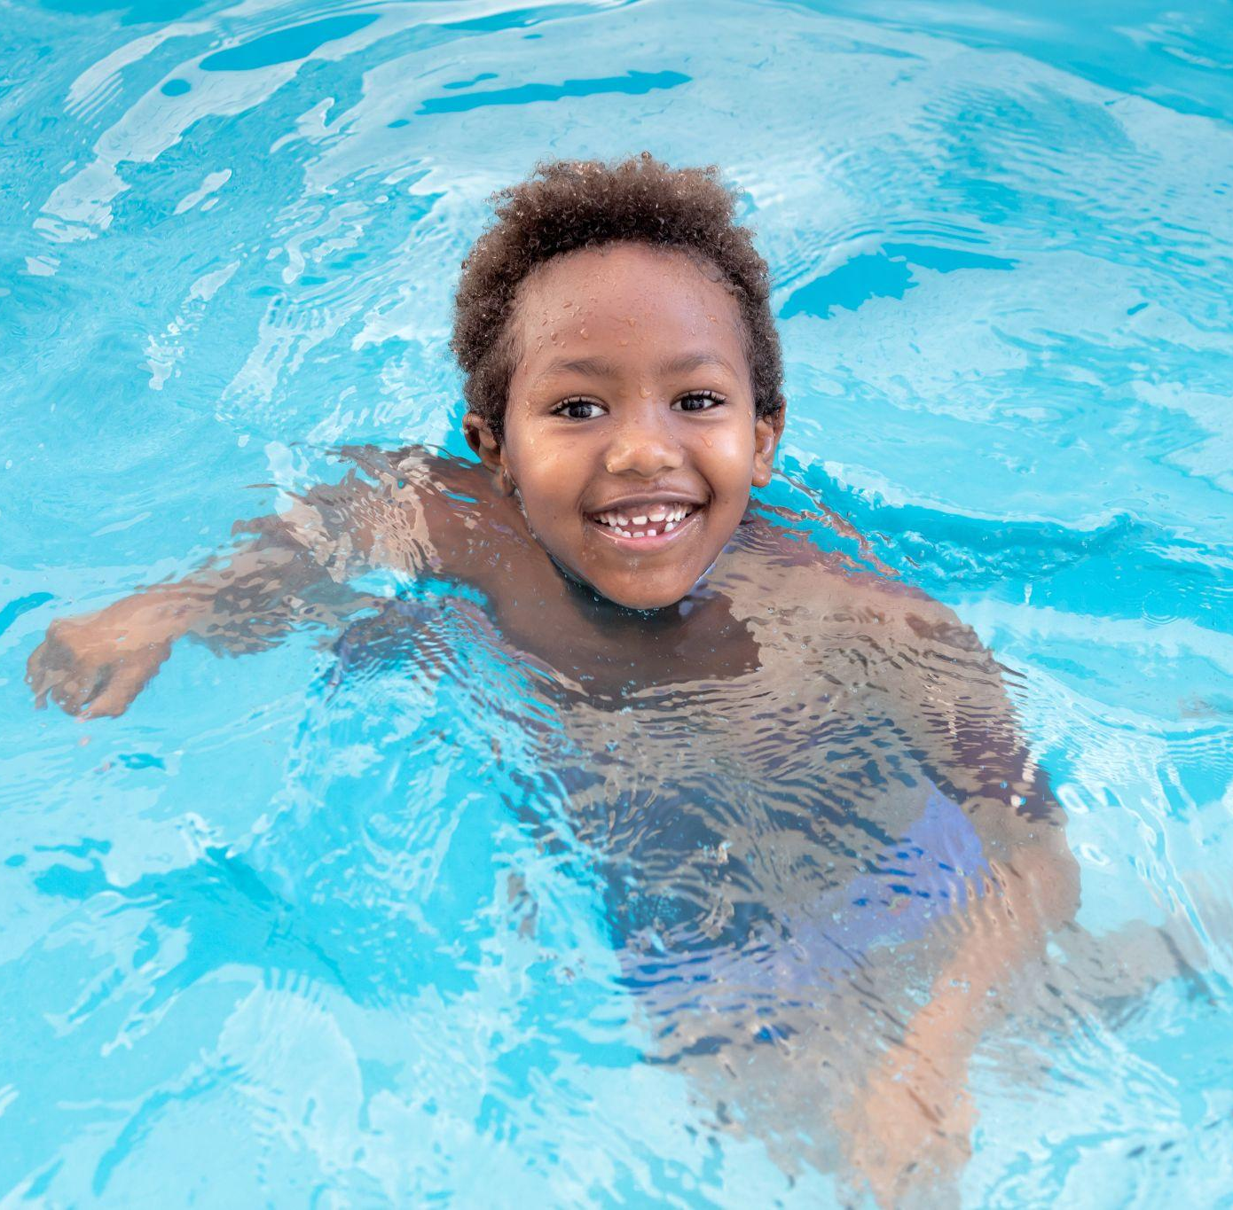
Collaborator Toolkit
June 2024 | V1

Slide 2
Table of
Contents
03
Messaging
10
Grant Program
12
PSA
14
Ask the Experts
16
Social Media
23
Visual Logo Library
27
Resources
35
Contact Information

Slide 3
SECTION 01
Messaging
|

Slide 4
Pool Safely Campaign Messaging
Please feel free to use these campaign messages when writing about or discussing Pool Safely and drowning prevention:
Pool Safely is a national public education campaign from the U.S. Consumer Product Safety Commission (CPSC).
Drowning is the leading cause of unintentional death among children ages 1-4. According to CPSC data released in June 2024, an average of 358 children drown in pools and spas annually. Additionally, each year there are an average of 6,500 non-fatal drowning injuries that need treatment at the emergency department.
Drownings happen quickly and often they are silent. It’s not like in the movies, where children are portrayed as splashing and yelling for help. Drownings are 100 percent preventable by following our simple water safety steps.
MESSAGING |

Slide 5
Supervision is one of the most important steps you can take to keep children safer in and around water. Designate a Water Watcher—this is an adult whose only job is to watch children while they’re in the pool . It’s important that the Water Watcher is not distracted by texting or phone calls.
Designate a
Water Watcher
Pool Safely Messaging—
Simple Steps
While supervision is critical, it is also important for children to learn how to swim. Kids who can’t swim face a much higher risk of drowning, so sign your children up for swimming lessons. Your local YMCA or parks and rec department are great places to go for information on swimming lessons—many even offer them free or at a reduced cost.
Teach Kids
to Swim
Simple steps can save lives. Parents and kids should follow these simple safety steps for a safer summer season.
Learn CPR
When your children are learning how to swim, it is important for you to learn CPR. In case of emergency, bystander CPR can often make a real difference while you’re waiting for emergency first responders to arrive at the scene.
Check Drain
Covers
Regardless of whether you’re swimming in your home pool, or visiting a public pool, be sure that all drain covers are not loose or broken. Drains should be “VGB compliant,” which means they meet safety standards. If you own a pool and you’re not sure about the safety of your drain covers, a pool technician can let you know.
Install Proper Barriers
Finally, most drownings happen during non-swim time, so we must prevent young children from being able to get near water if an adult isn’t nearby. In particular, installing more and even stronger layers of protection is key to prevention. One of the best layers of protection is 4-sided fencing with a self-closing, self-latching gate around all pools and spas. Homes should also use pool covers and door alarms for added barriers.
MESSAGING |

Slide 6
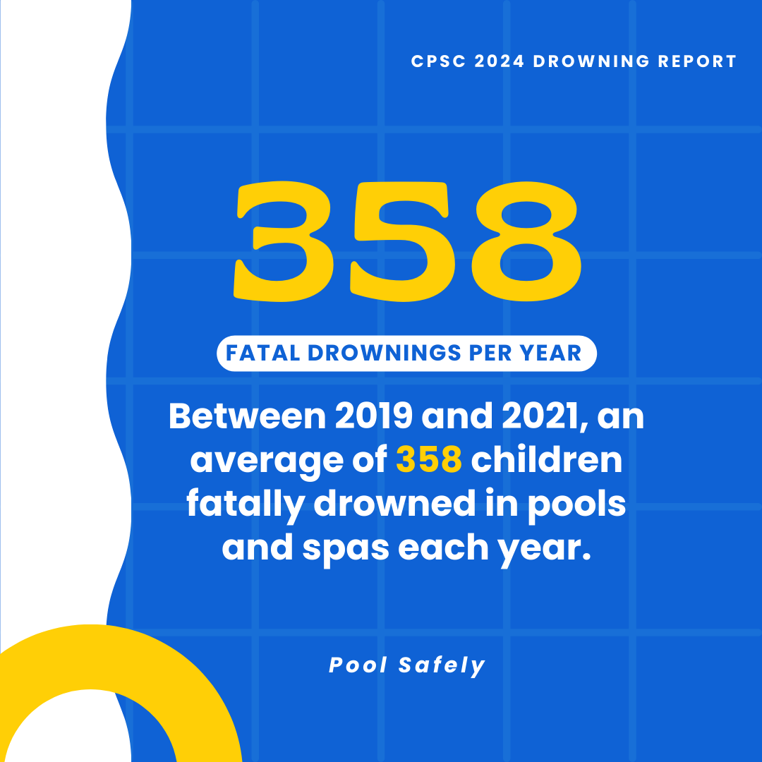
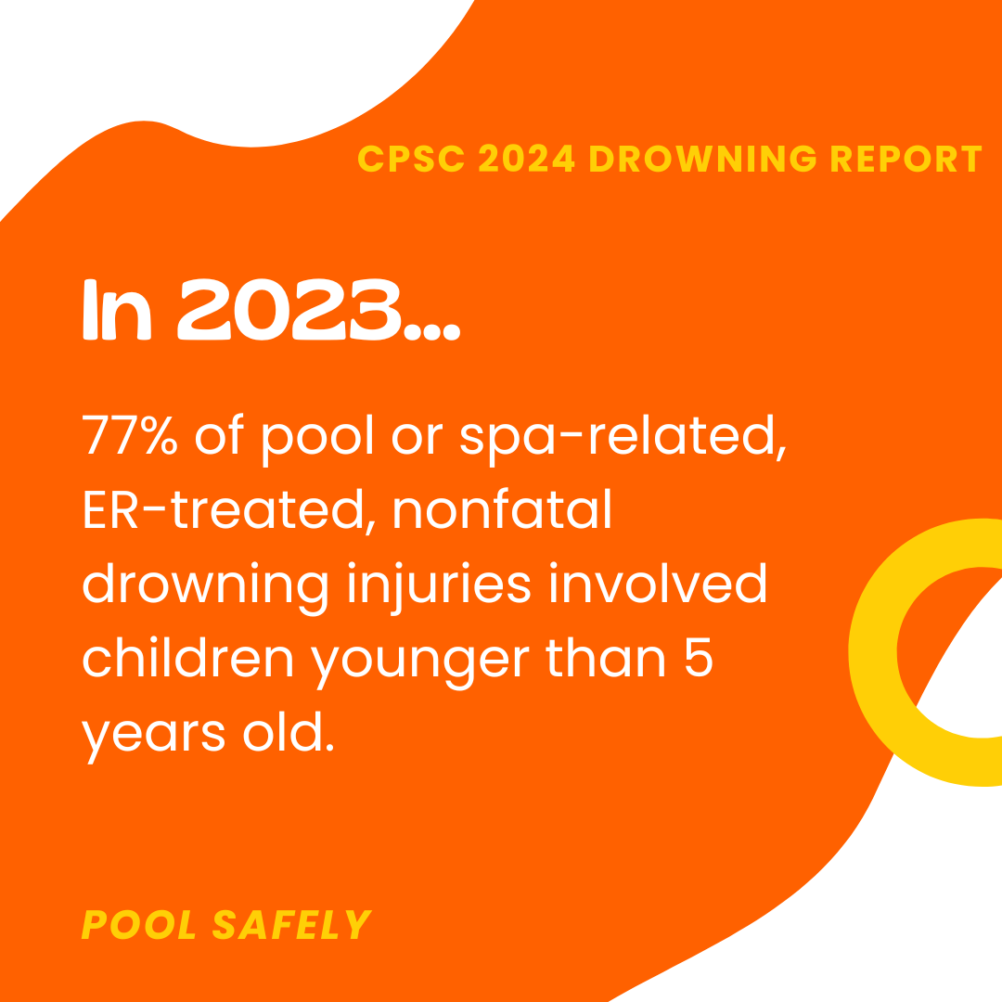
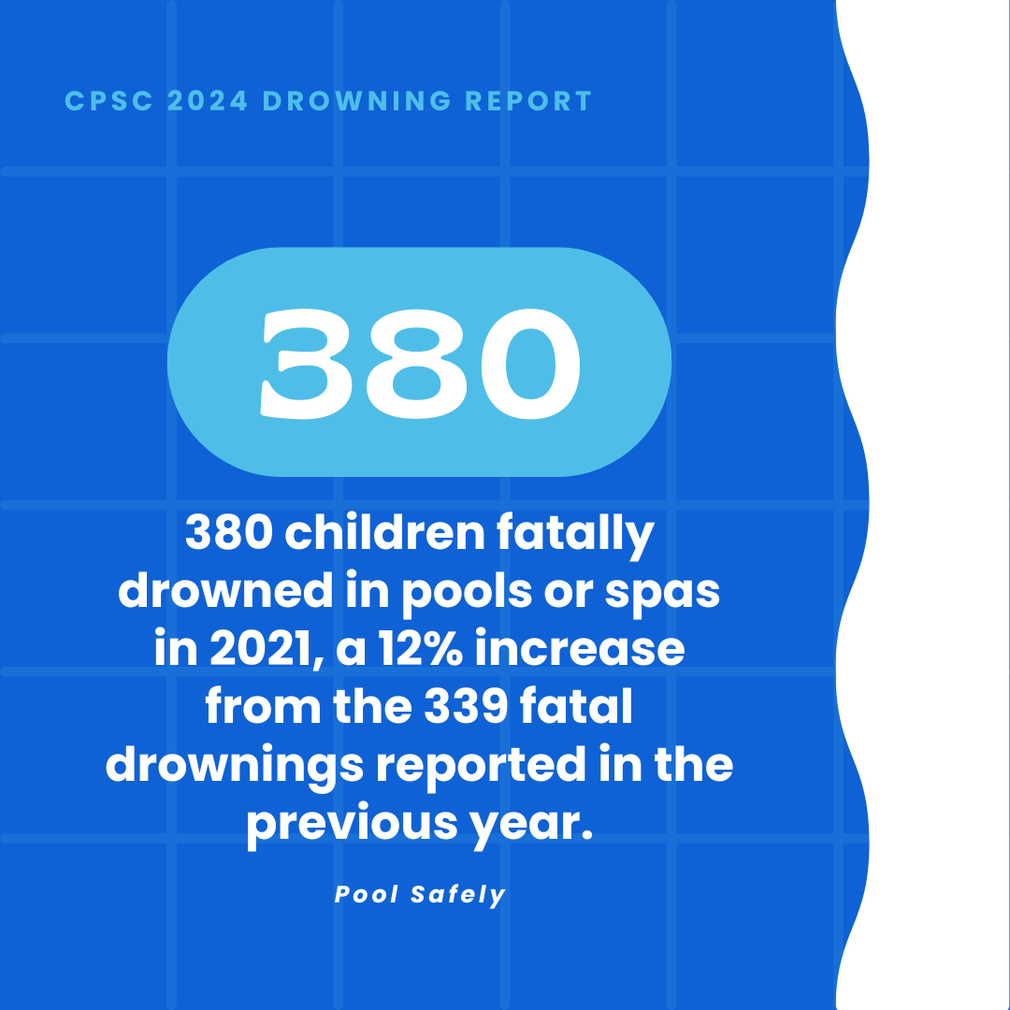
2024 Drowning Data and Messaging
In 2024, CPSC released the following data via its drowning and drain entrapment report:
MESSAGING |

Slide 7
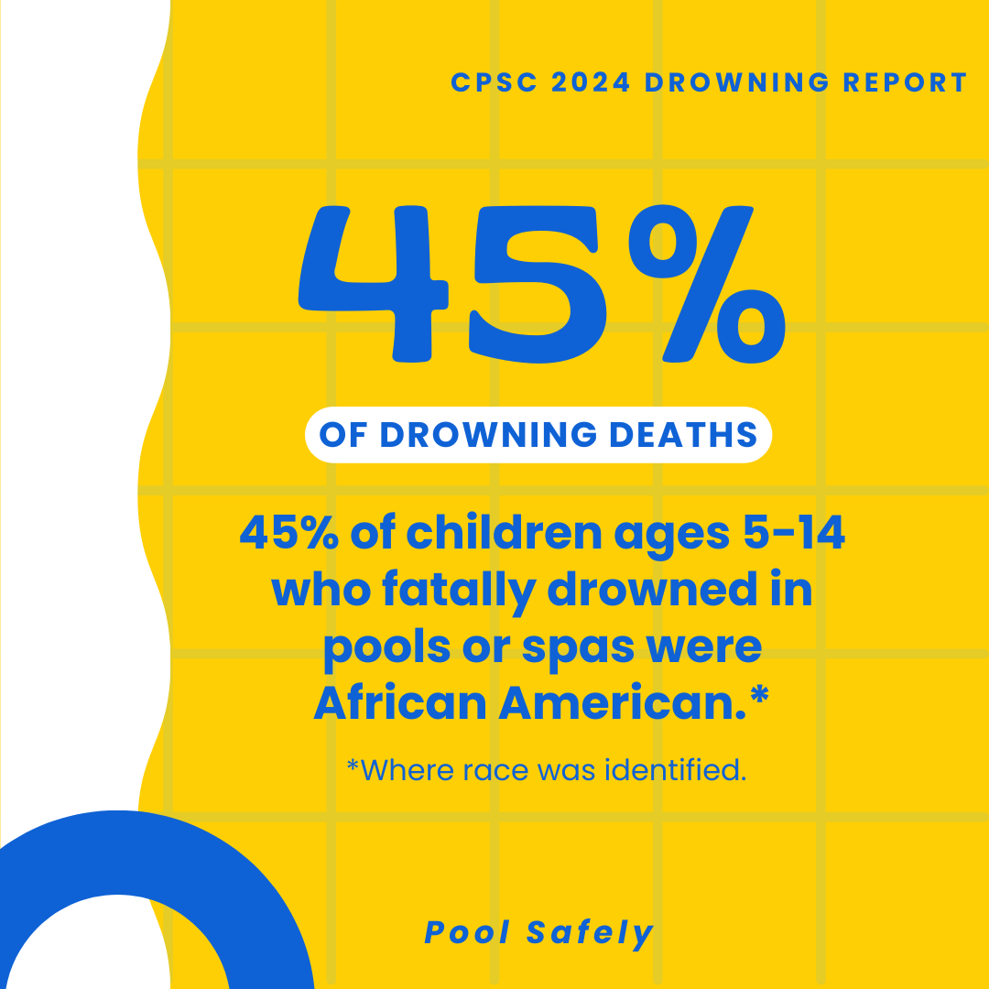
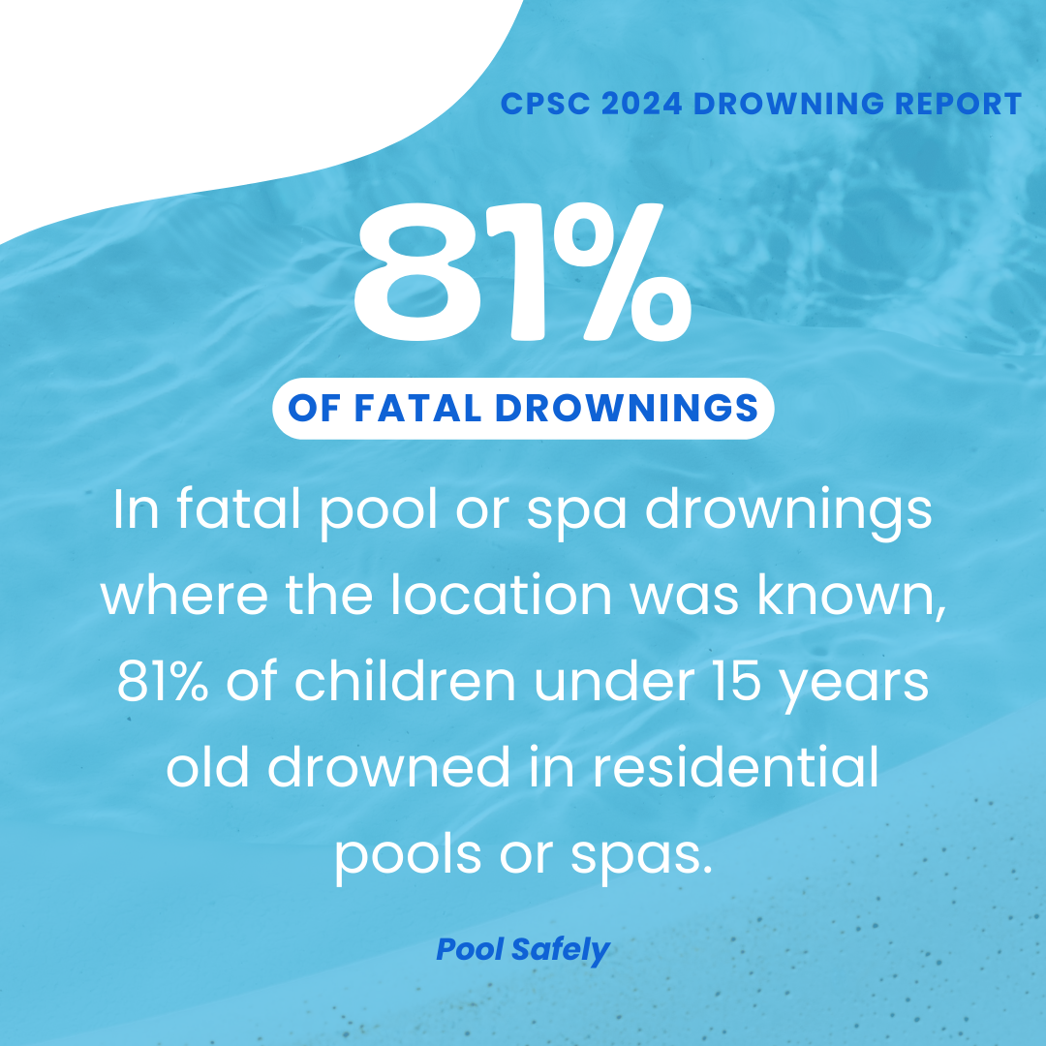
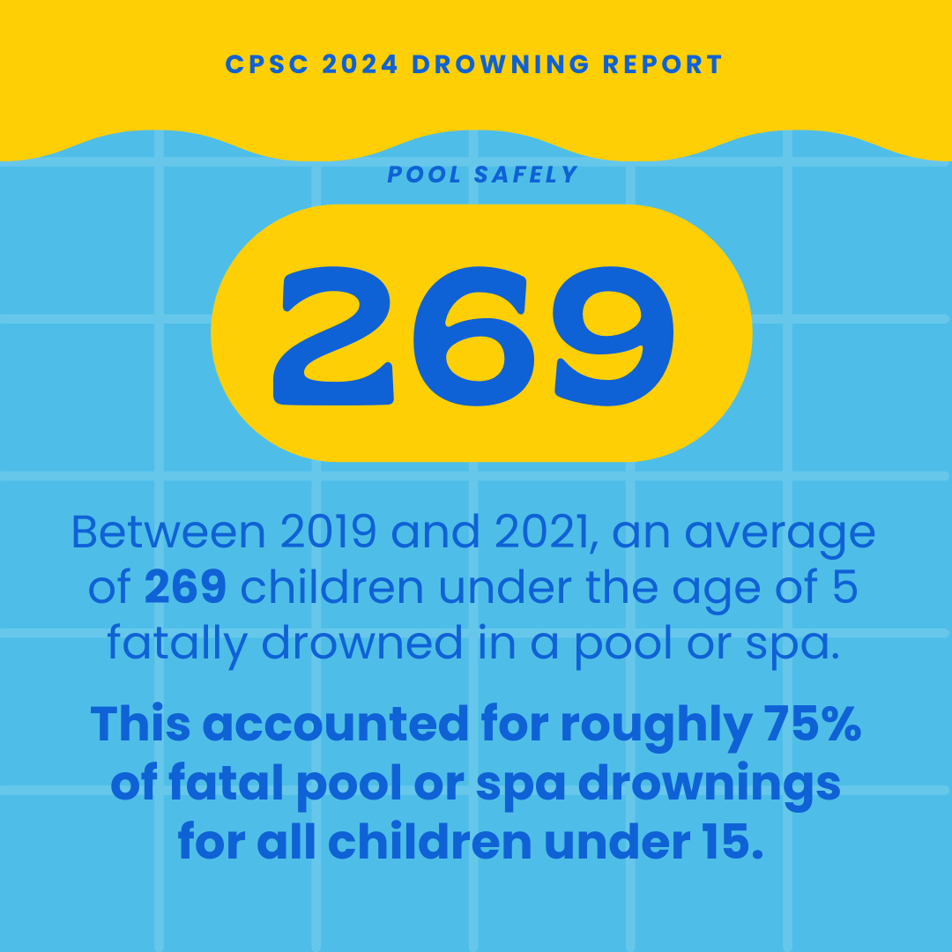
2024 Drowning Data and Messaging
MESSAGING |

Slide 8
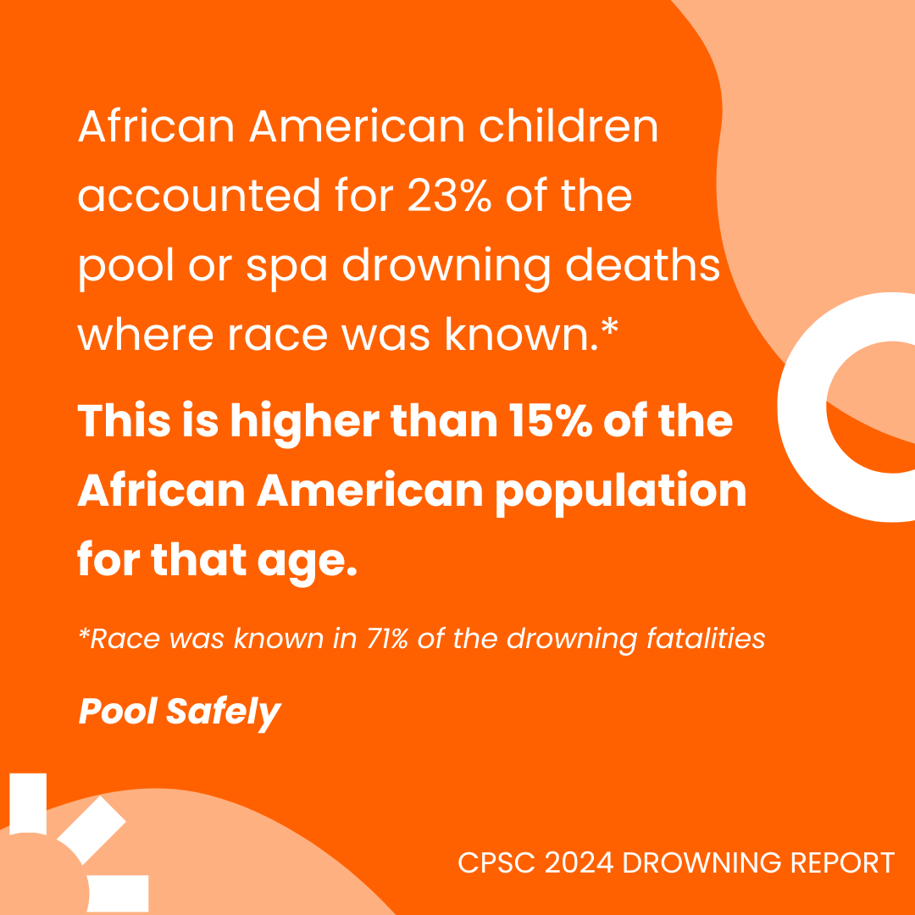
2024 Drowning Data and Messaging
MESSAGING |

Slide 9
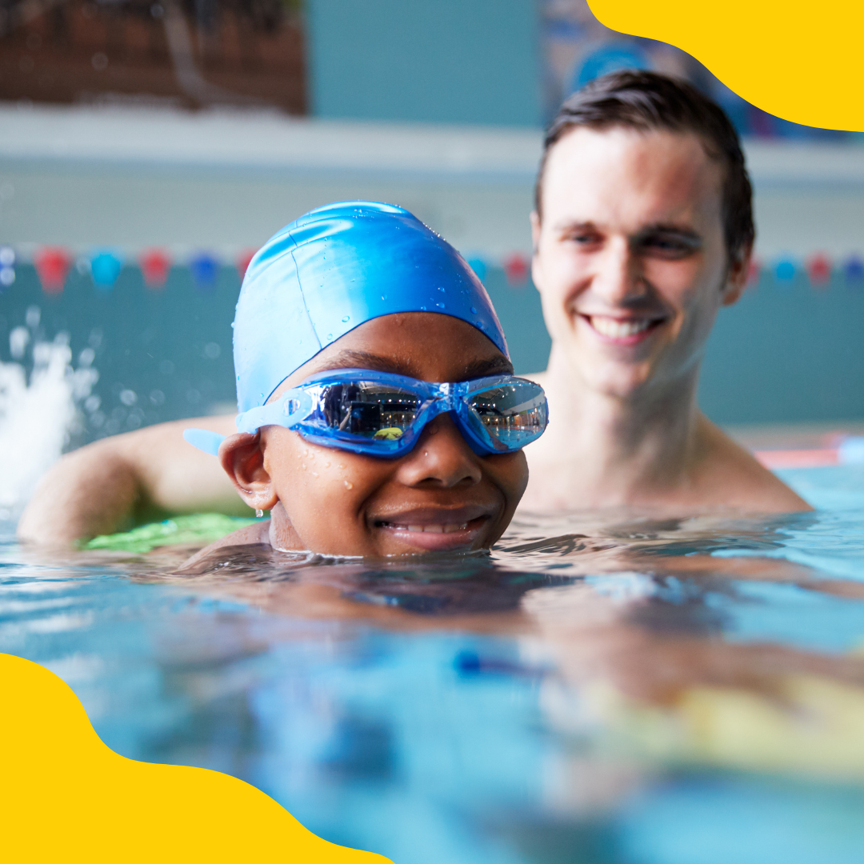
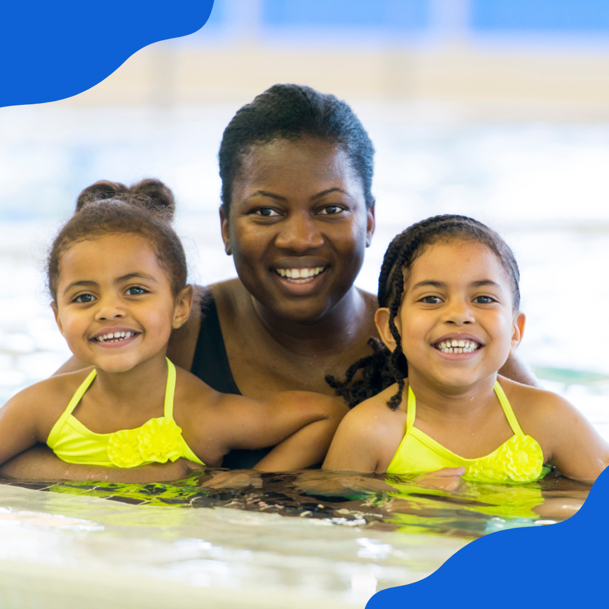
Pool Safely
Outreach
The Pool Safely campaign is reaching out to Black American and Hispanic American families via media outreach and collaborator engagement.
Research from the USA Swimming Foundation shows 64 percent of Black American children and 45 percent of Hispanic children have low/no swimming ability.

Slide 10
SECTION 02
Grant Programming
|

Slide 11
Pool Safely Grant Program: Open Now!
In accordance with the Virginia Graeme Baker Pool and Spa Safety Act, CPSC annually accepts applications for the Pool Safely Grant Program (PSGP). This program provides state, local, county, and tribal governments with assistance to help implement endorsement and education programs, with the goal of preventing drownings and drain entrapments in pools and spas.
In FY24, CPSC will award a total of up to $3 million in two-year grants to assist jurisdictions in reducing deaths and injuries from drowning and drain entrapment incidents in pools and spas. Applications for this year will be accepted through July 12, 2024.
Visit www.poolsafely.gov/grant-program/ to view previous awardees and learn more about the application process.
GRANT PROGRAM |

Slide 12
SECTION 03
Public Service Announcement

Slide 13
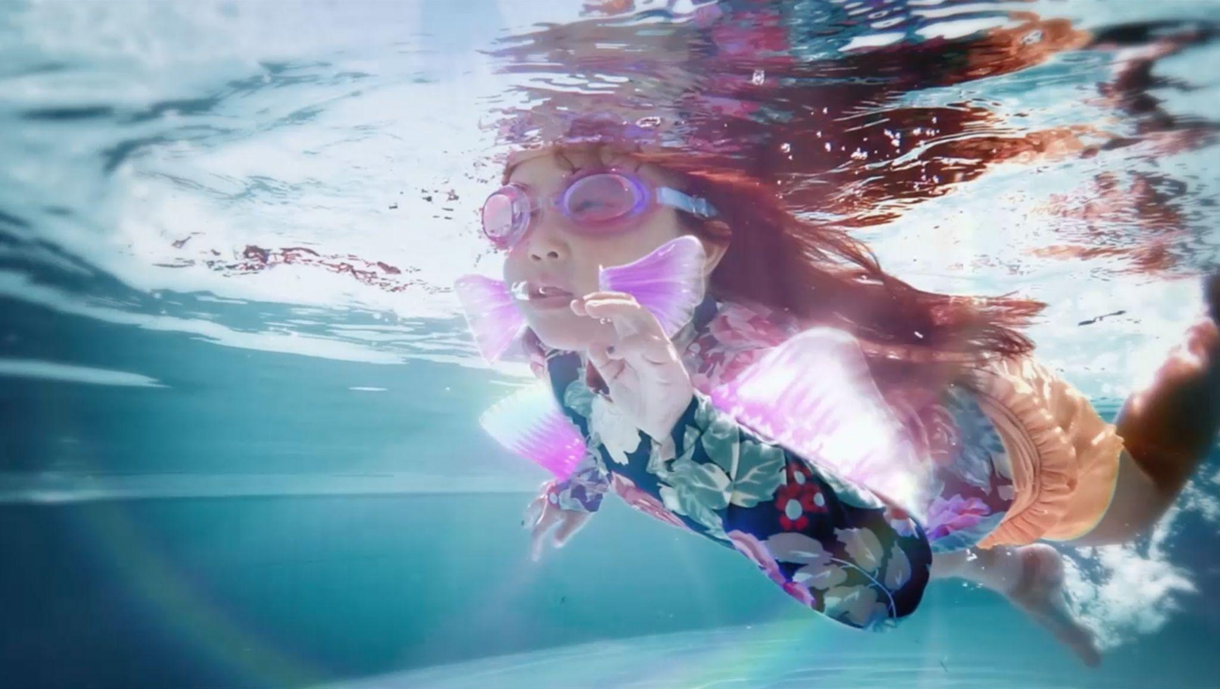
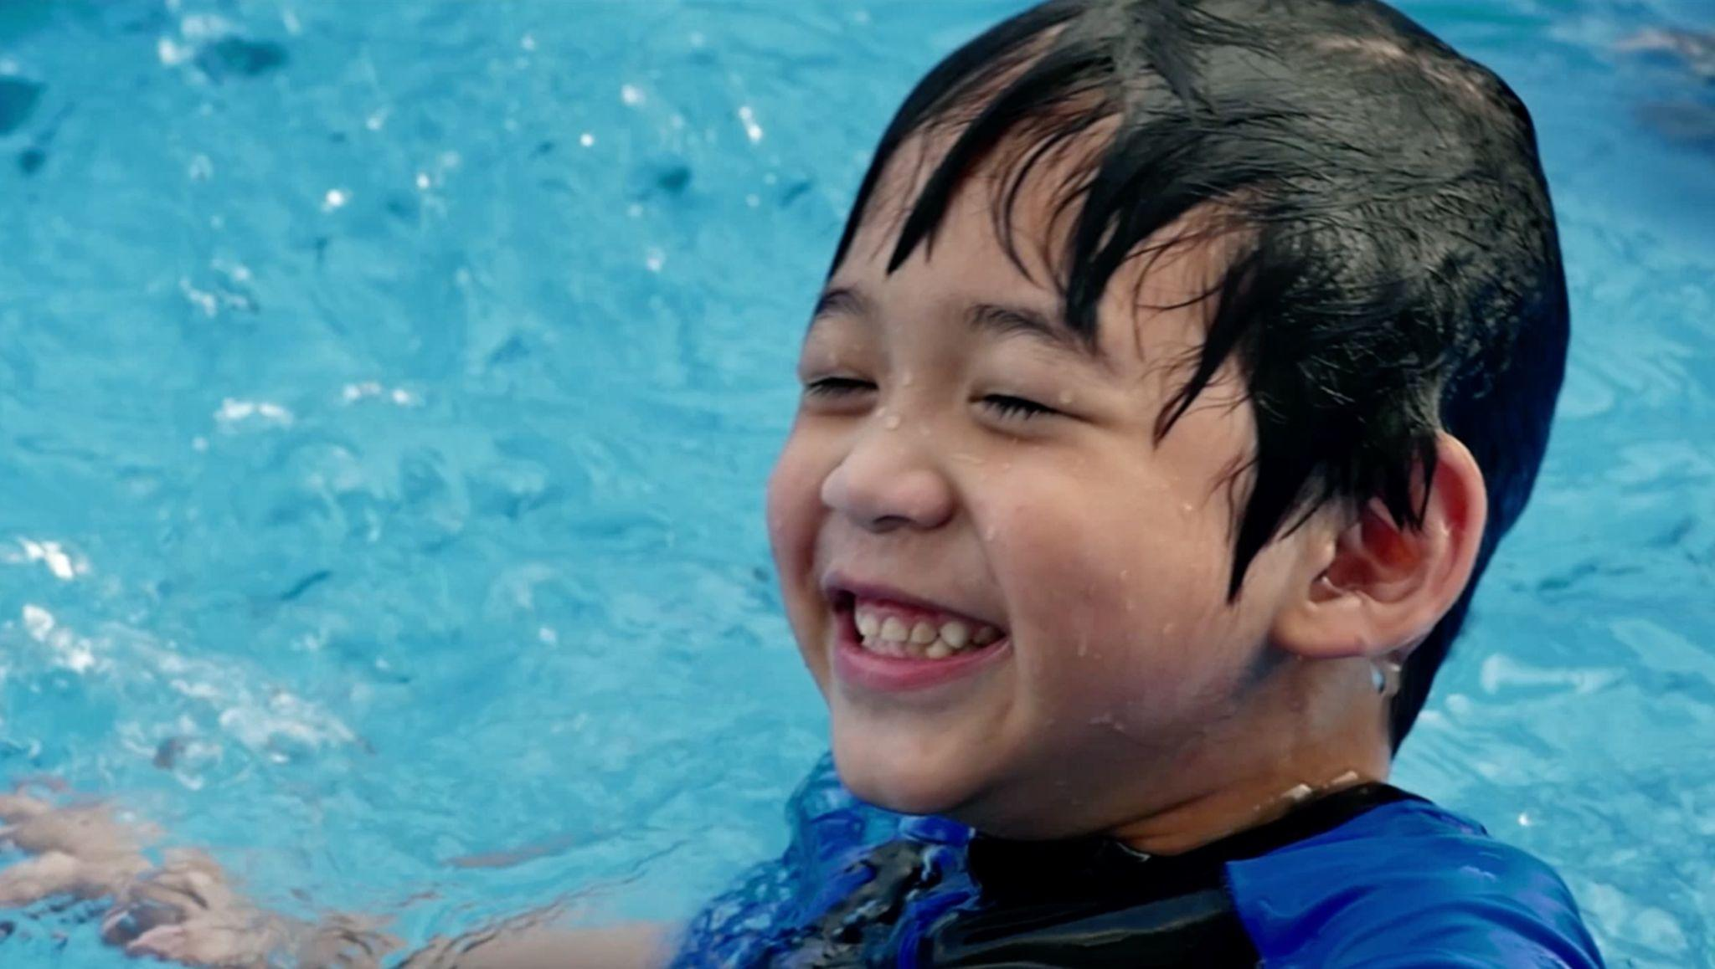
PSA: Gills and Fins
What if kids were born with gills and fins? Then no parent or caregiver would ever have to worry about their safety in water. Pool Safely recently released a new public service announcement (PSA) which imagines this very scenario.
Launched in both English and Spanish, the PSA emphasizes the fact that children do not possess built-in swimming abilities and each year, drowning is a leading cause of death for young kids. Because we can never assume children aren’t in danger while in and around water, the PSA urges parents to keep children safe by following the simple safety steps.
Watch and share the PSA, using the links below:
English: https://bit.ly/3hUKul4
Spanish: ​https://bit.ly/3ckz5cU
PUBLIC SERVICE ANNOUNCEMENT |

Slide 14
SECTION 04
Ask the Experts
|

Slide 15
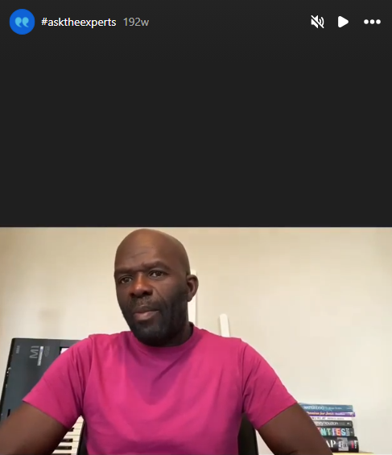
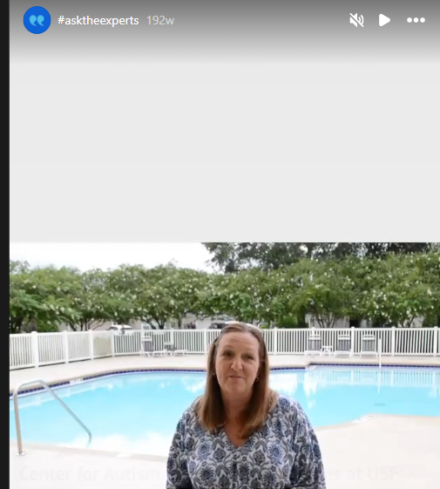
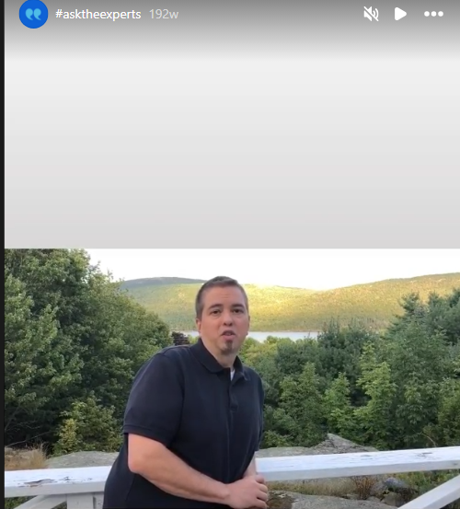
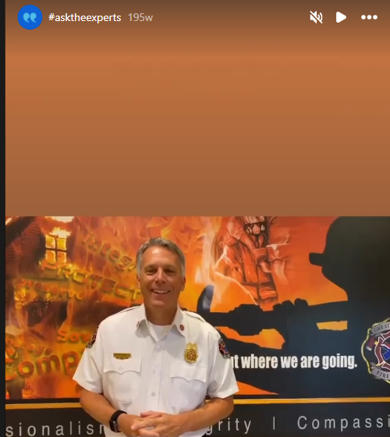
Ask the Experts
New data from CPSC’s latest submersion and entrapment report shows that drownings remain high, with 81 percent of pool-or-spa-related fatal drowning incidents occurring at residential locations, often places without lifeguards leaving non-professional adults to take over pool safety.
Pool Safely’s Ask the Experts video series is here to help adults learn how to keep children safer. Collaborating with our community of drowning prevention experts, advocates and Olympians, each video features advice about how to Pool Safely at home, or anywhere you’re spending time around water.
The series includes tips from Olympians such as Rowdy Gaines and Maritza McClendon, and Pool Safely collaborators such as the American Red Cross, Diversity in Aquatics, Nicole Phelps on behalf of the Michael Phelps Foundation, and the U.S. Swim School Association.
Head over to our YouTube page or Instagram page to watch and share the videos. If you’re interested in submitting a video of your own, email PoolSafely@FinnPartners.com.
This is an example of a potential brand implementation that would evoke social media posting, branded engagement, and shareable moments. Social activations are an important aspect of growing the brand.v
ASK THE EXPERTS |

Slide 16
SECTION 05
Social Media

Slide 17
Pool Safely Hashtags
English
#PoolSafely365
#stopdrowning
Campaign hashtags to use when posting about Pool Safely on social media:
#PoolSafely
#WaterSafety
Spanish
#PiscinaSegura
#ComparteLaPromesa
SOCIAL MEDIA |

Slide 18
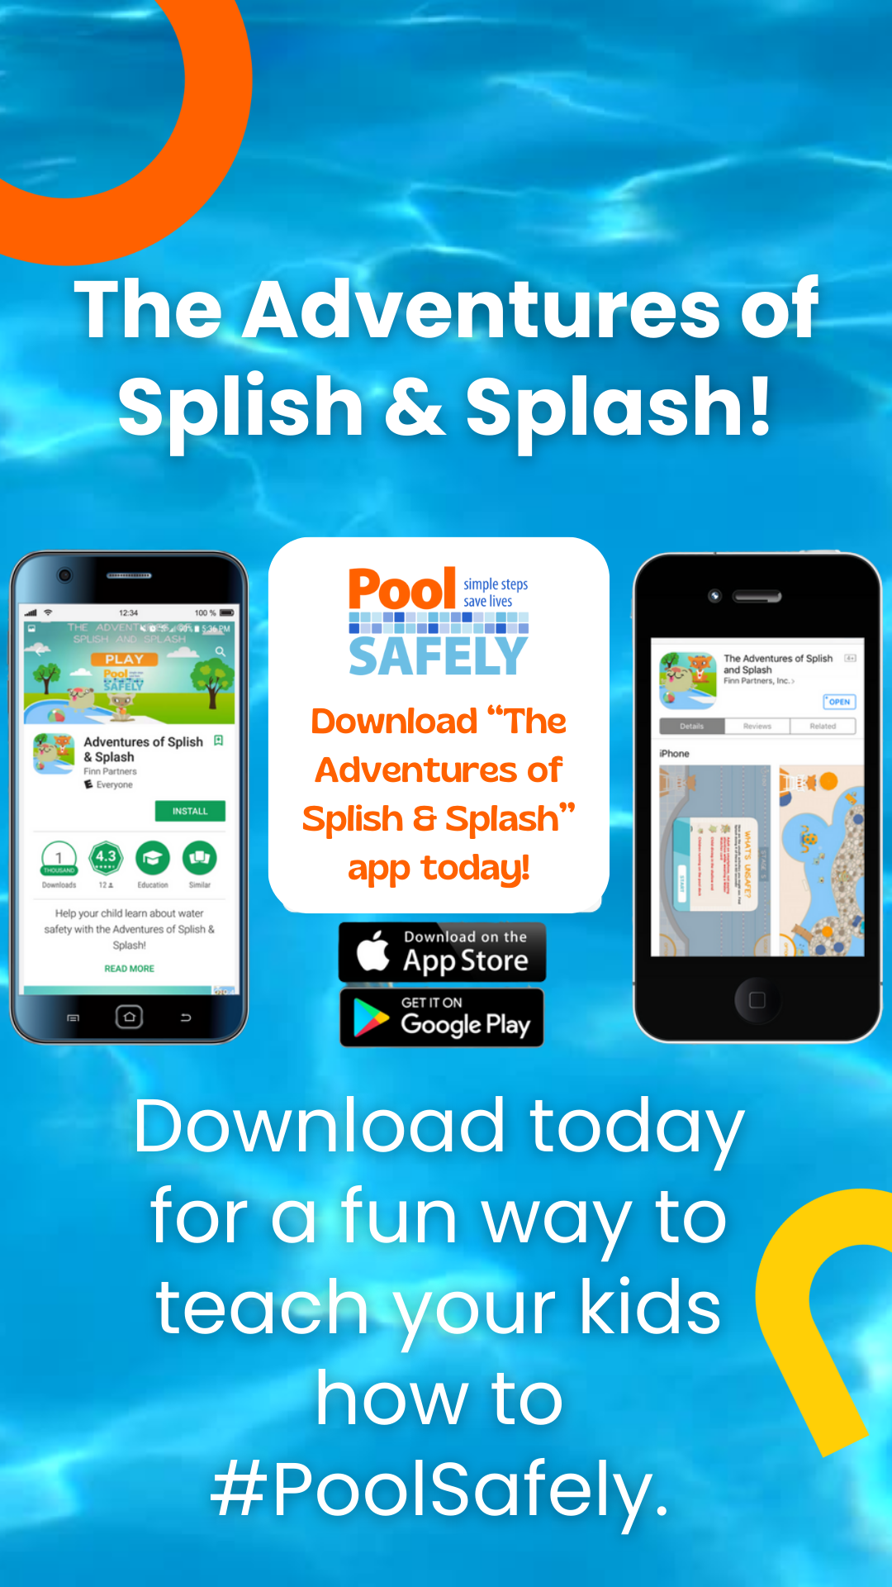
Follow Pool Safely on Instagram
Pool Safely is on Instagram! Follow and tag us @PoolSafely. Feel free to share any of the below posts on your Instagram page, using any of the images in our visual library (starting on slide 23 of this toolkit).
#FunFact: Pool Safely recommends having a Water Watcher even when there is a lifeguard on duty. The more eyes supervising kids in the pool, the better!
Looking for affordable swim lessons? You can enroll your children in free or reduced cost swimming lessons at your local YMCA, USA Swimming Chapter, or Parks and Recreation department—and remember, it’s never too late to learn!
Performing CPR on a drowning victim immediately after an incident can double—or even triple—their chance of survival. Learn how to perform CPR on children and adults to save a life.

Slide 19
Pool owners: ensure your pool drains are compliant with the Virginia Graeme Baker Act to prevent entrapment accidents. Regularly inspect and maintain them to keep your swimming experience worry-free! 🏊‍♂️💦
Join the movement for safer swimming! Take the Pool Safely Pledge today to commit to water safety practices like supervision, barriers, and knowing CPR: https://bit.ly/425by82
Sample Social Media Posts: Threads
Please feel free to share any of these sample posts on your Threads account—or write your own using these as a guide! You can also repost us from @PoolSafely.
Water safety isn’t a me thing, it’s a we thing! Let's spread awareness about drowning prevention— water watchers, swimming lessons, barriers, and CPR knowledge save lives. Together, we can prevent tragedies.
Want to talk to your kids about pool safety but don’t know where to start? Listen to Laurie Berkner’s Pool Safely Song to learn water safety in a fun way: https://bit.ly/3MS5kUL
SOCIAL MEDIA |

Slide 20
04
/ 04
Sample Social Media Posts: Facebook
Do you have an alarm installed in your pool? This Pool Safely video shows how a pool alarm is one step you can take to keep your kids safer in the water: https://bit.ly/3PsjUnE
Feel free to share any of these posts on your Facebook page—or write your own using these as a guide! You can tag the Pool Safely Facebook page in your posts as well: @PoolSafely.
As kids are heading back to school, remember that math and reading aren’t the only subjects to learn about. Learning to swim is an important step for all kids to help keep them safer in the water.
SOCIAL MEDIA |

Slide 21
Sample Social Media Posts: X
Calling all grandparents! If you’re planning a trip to the community pool with your grandkids this summer, make sure to brush up these water safety tips: https://t.co/TCeh3WqZXn
Remember, always keep an eye on little ones around water and use proper barriers when pool time is over. Let's make a splash while staying safe! 💦☀️ #PoolSafely #SummerSafety
Please feel free to share any of these sample posts on your X account—or write your own using these as a guide! You can also repost us from @PoolSafely.
Drowning remains the leading cause of death for children ages 1-4. Let's change this statistic by promoting swim lessons, ensuring constant supervision, using proper barriers, and learning how to perform CPR.
Attention home pool owners! Have you had your drain covers checked lately by a pool professional? Remember to regularly check them before pool season begins to prevent entrapments.
SOCIAL MEDIA |

Slide 22
Sample Social Media Posts: Spanish
X/Threads
¿Tienes una piscina? Asegúrate de que los desagües de tu piscina cumplan con la Ley Virginia Graeme Baker para prevenir accidentes por atrapamiento. Inspecciónalos y hazles mantenimiento regularmente para disfrutar de la piscina sin preocupaciones. 🏊‍♂️💦
¡La seguridad acuática es responsabilidad de todos! Trabajemos juntos para prevenir los ahogamientos: los vigilantes del agua, las clases de natación, las cercas y barreras y el RCP salvan vidas. Juntos, podemos prevenir tragedias.
¿Quieres hablar con tus hijos sobre la seguridad acuática pero no sabes por dónde empezar? Escucha la canción de Piscina Segura de Laurie Berkner para aprender sobre la seguridad en el agua de una manera divertida: https://bit.ly/3MS5kUL
¡Atención abuelos! Si estás planeando un viaje a la piscina comunitaria con tus nietos este verano, asegúrate de repasar estos consejos de seguridad en el agua: https://bit.ly/3q9wPAk
Facebook/Instagram
¿Estás buscando clases de natación para tus hijos? Puedes inscribirlos en clases de natación gratuitas o de costo reducido en tu YMCA local, sede de USA Swimming o departamento de Parques y Recreación. Y recuerda, ¡nunca es demasiado tarde para aprender!
Realizar RCP a una víctima de ahogamiento inmediatamente después del incidente puede duplicar, o incluso triplicar, sus posibilidades de sobrevivir. Aprende cómo realizar RCP en niños y adultos para salvar una vida.
A medida que los niños regresen a clases, recuerda que las matemáticas y la lectura no son las únicas materias que deben aprender. Aprender a nadar es un paso importante para mantener más seguros a los niños en y cerca del agua.

Slide 23
SECTION 06
Visual Logo Library
|

Slide 24
Visual/Logo Library
Please note we have updated logos. You can include any of these English/Spanish logos or images in social media posts, newsletters, or on your website (Please be sure to attribute them to Pool Safely).
VISUAL LOGO LIBRARY |

Slide 25
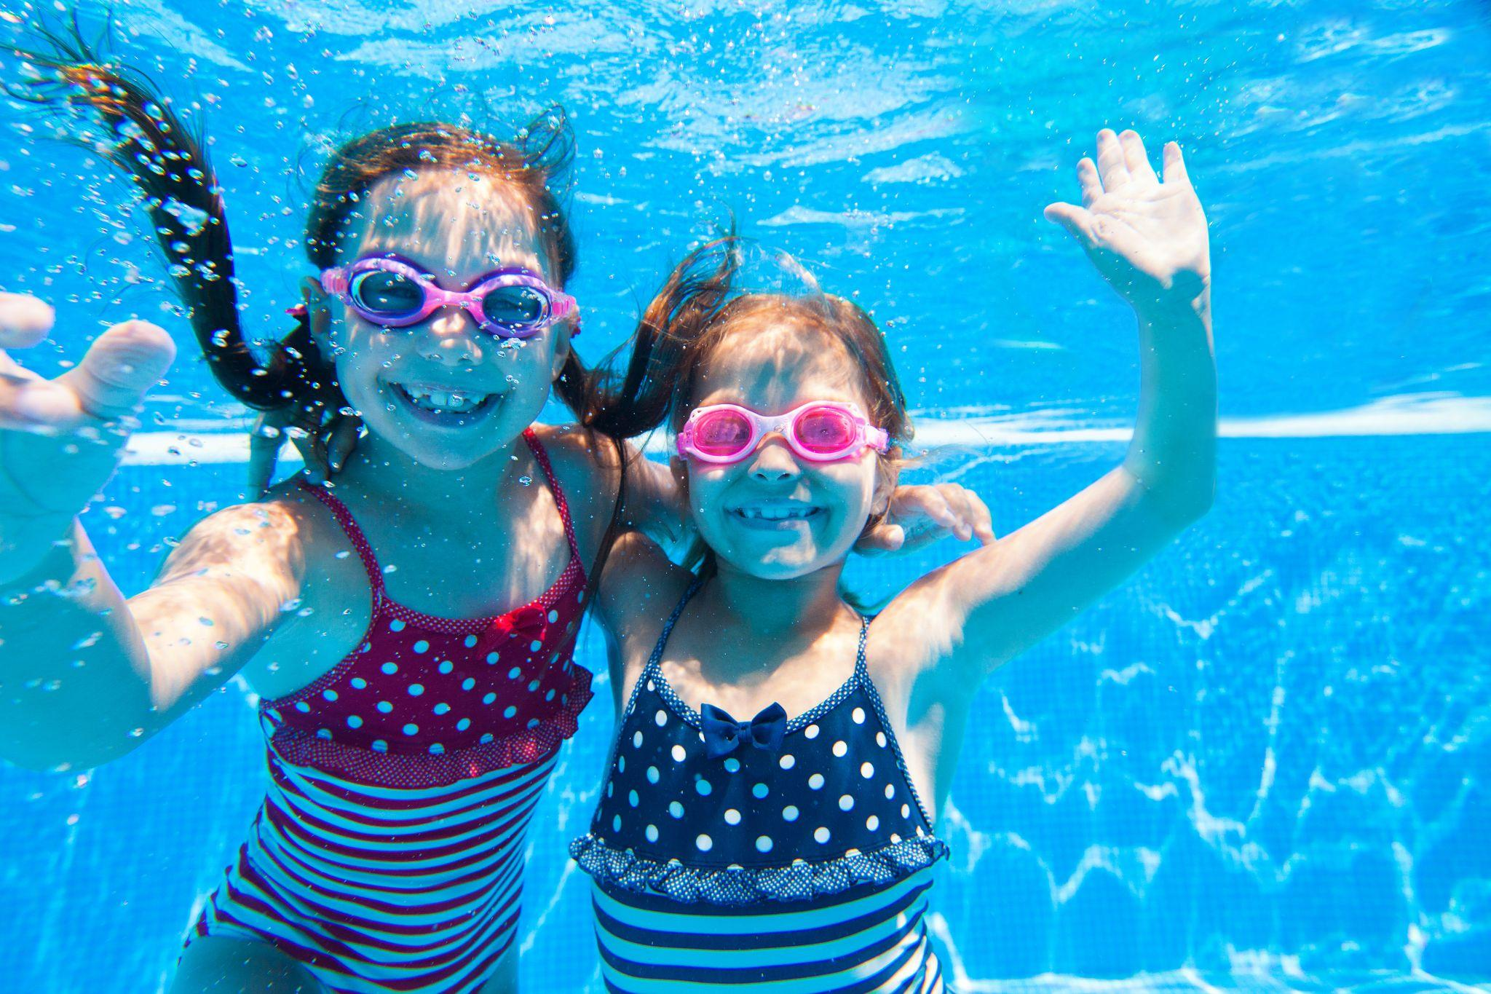
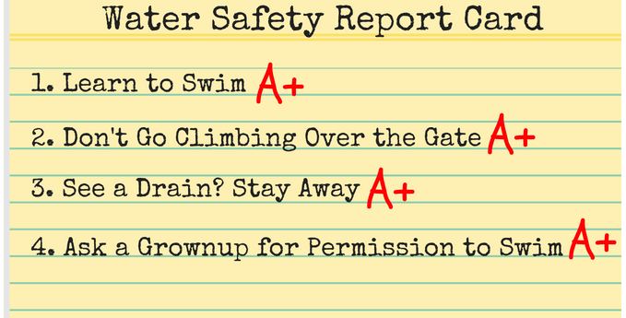
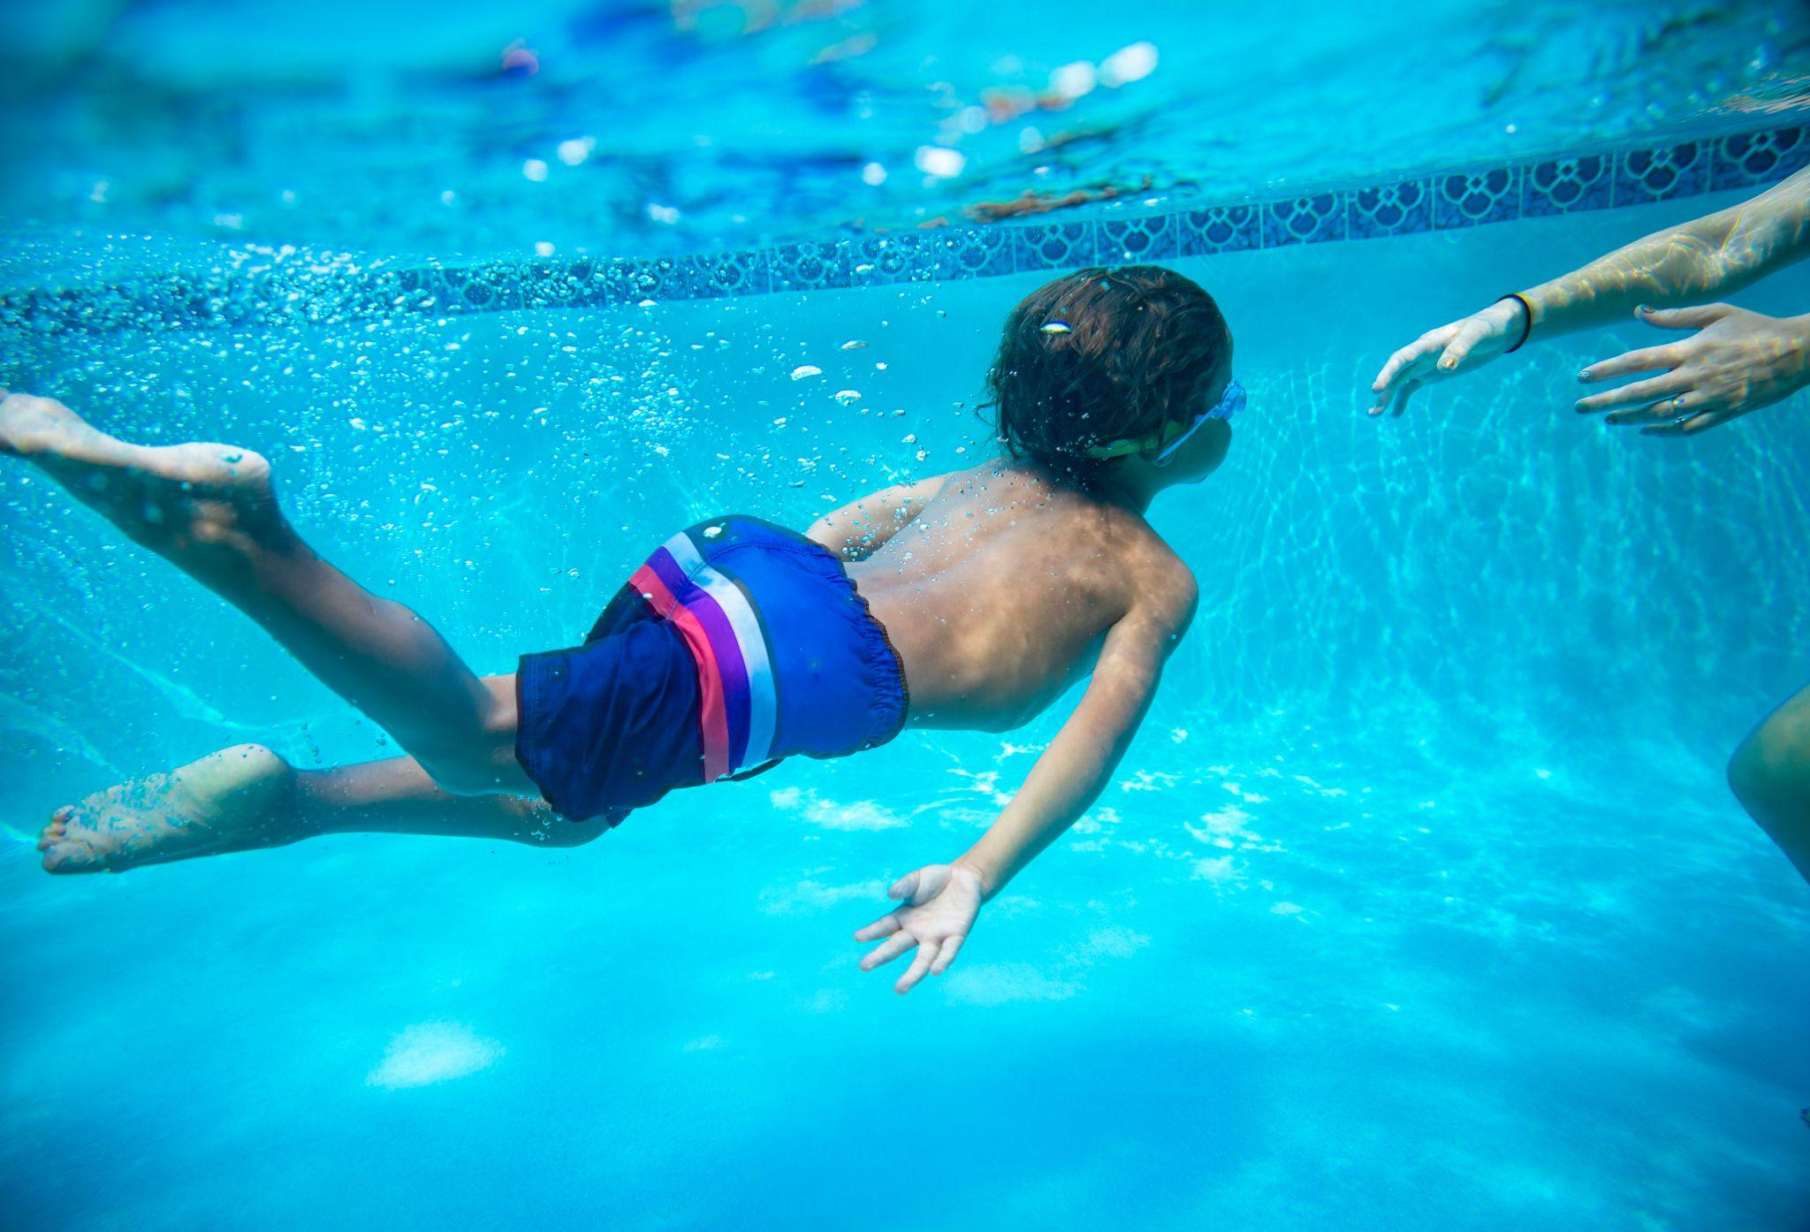
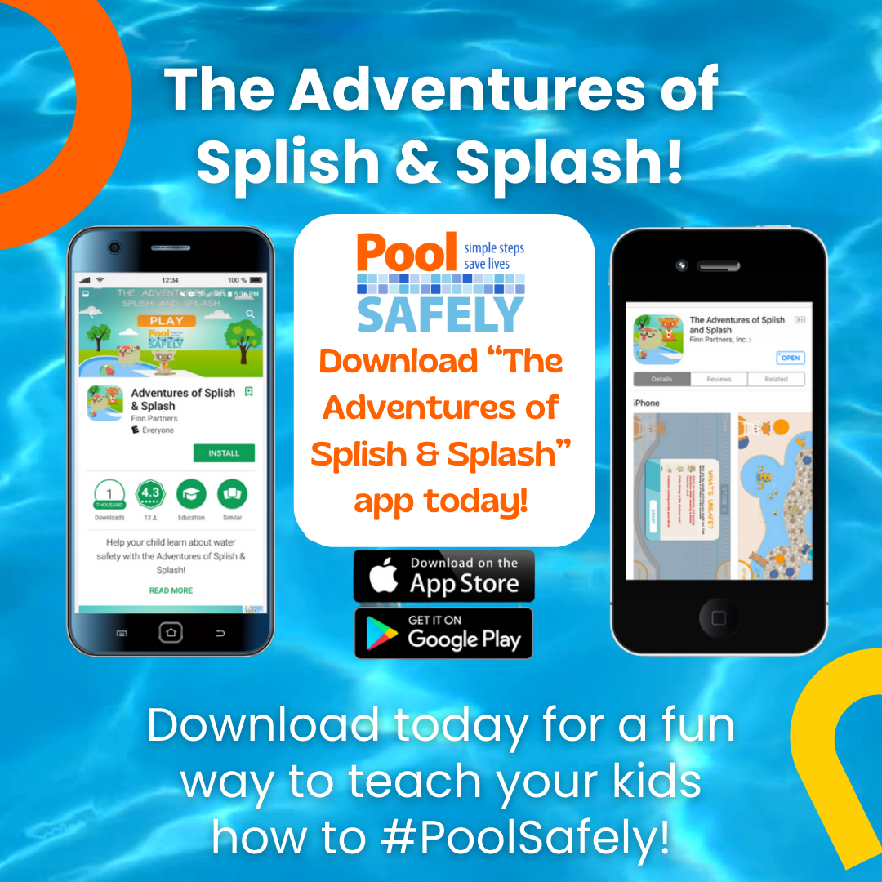
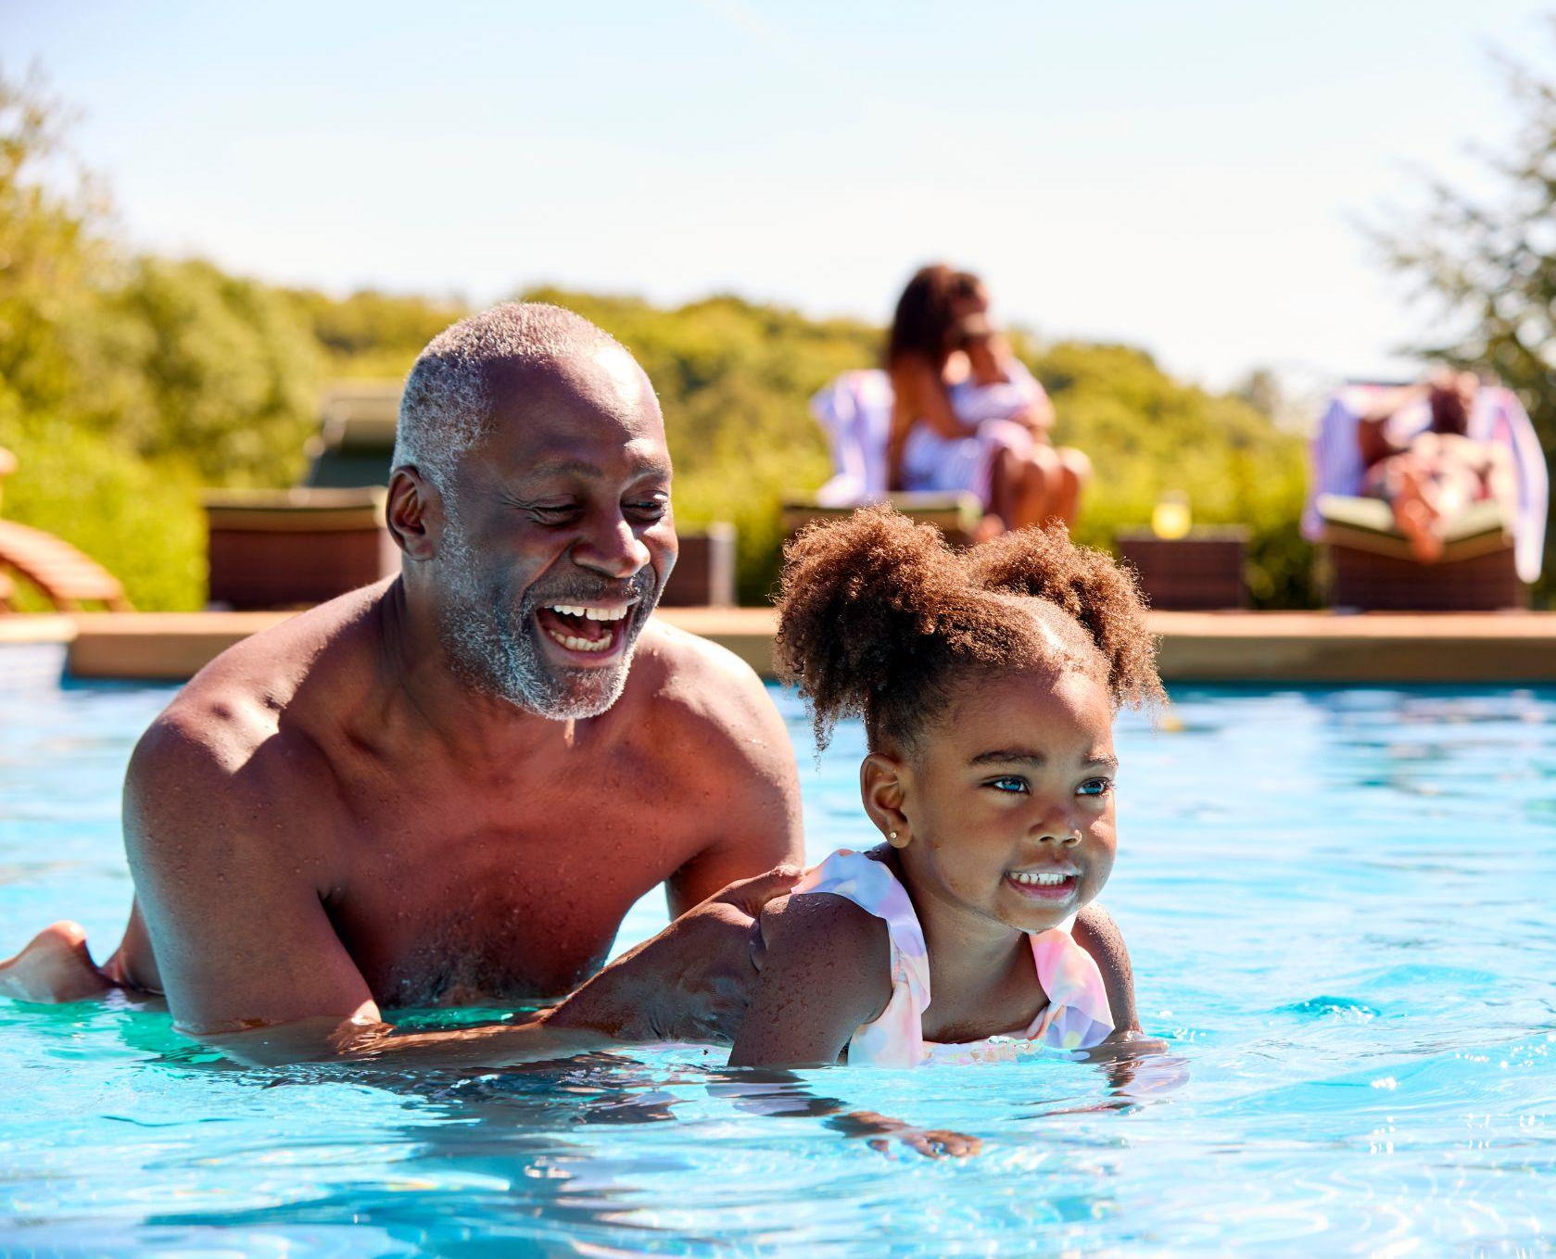
VISUAL/LOGO LIBRARY |

Slide 26
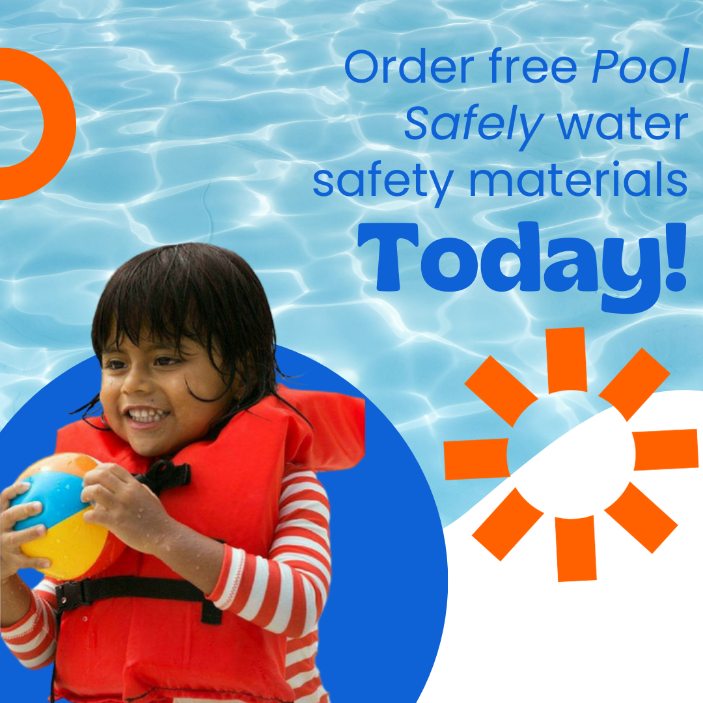
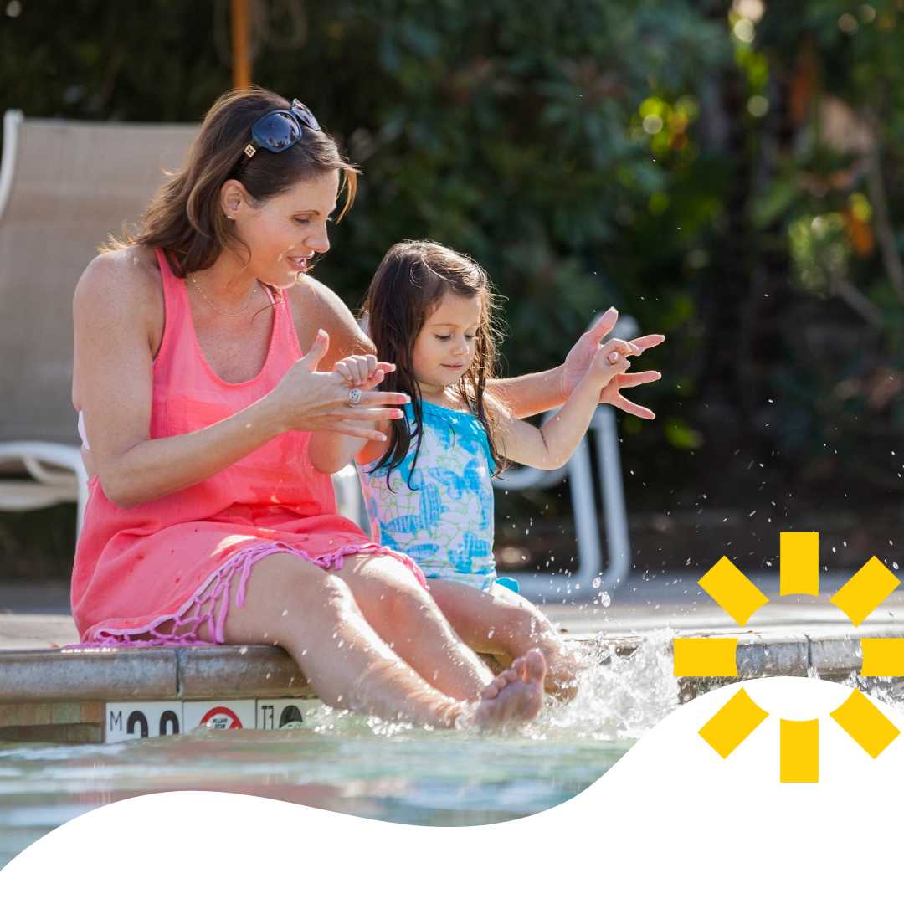
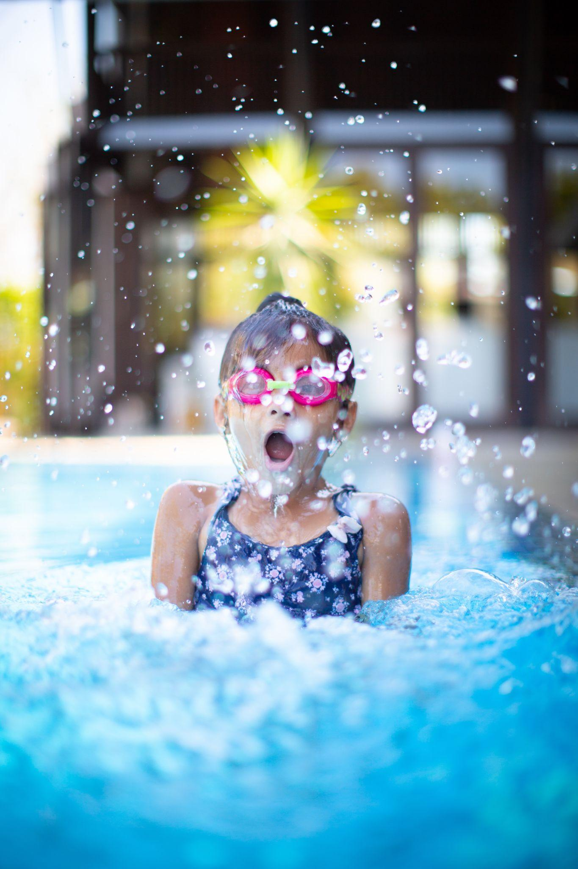
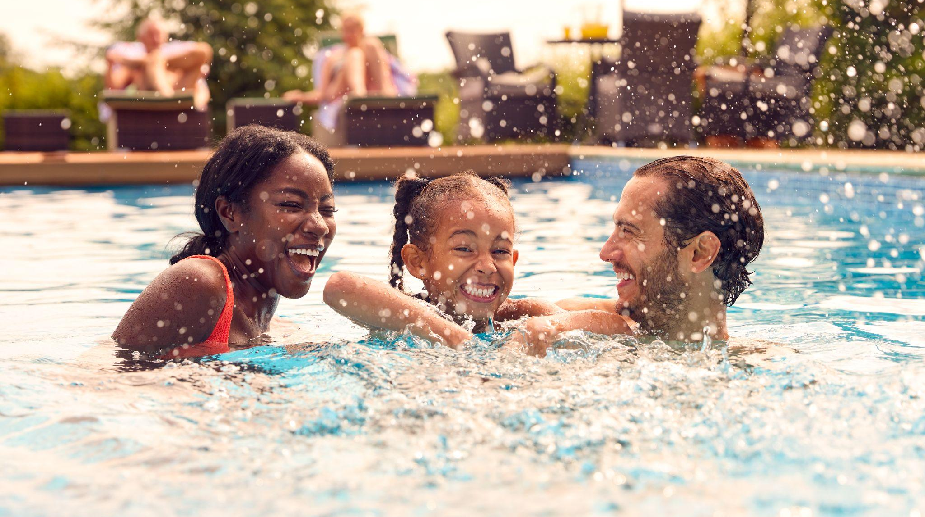
COLLABORATOR TOOLKIT 2023
VISUAL/LOGO LIBRARY |

Slide 27
SECTION 07
Resources
|

Slide 28
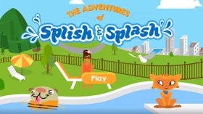
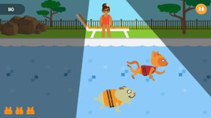
The Adventures of Splish & Splash
The Pool Safely app helps children learn about the dos and don’ts of water safety.
To download the app on iPhone or Android, click the link below: https://www.poolsafely.gov/parents/kids-corner/
RESOURCES |

Slide 29
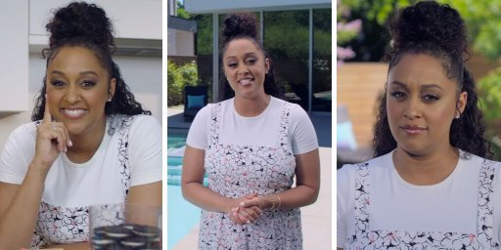
Pool Safely Video with Tia Mowry
To watch a full video featuring Tia Mowry sharing Pool Safely tips, click the link below:
https://www.poolsafely.gov/blog/behind-the-scenes-tia-mowry-urges-families-to-pool-safely-in-new-video/
RESOURCES |

Slide 30
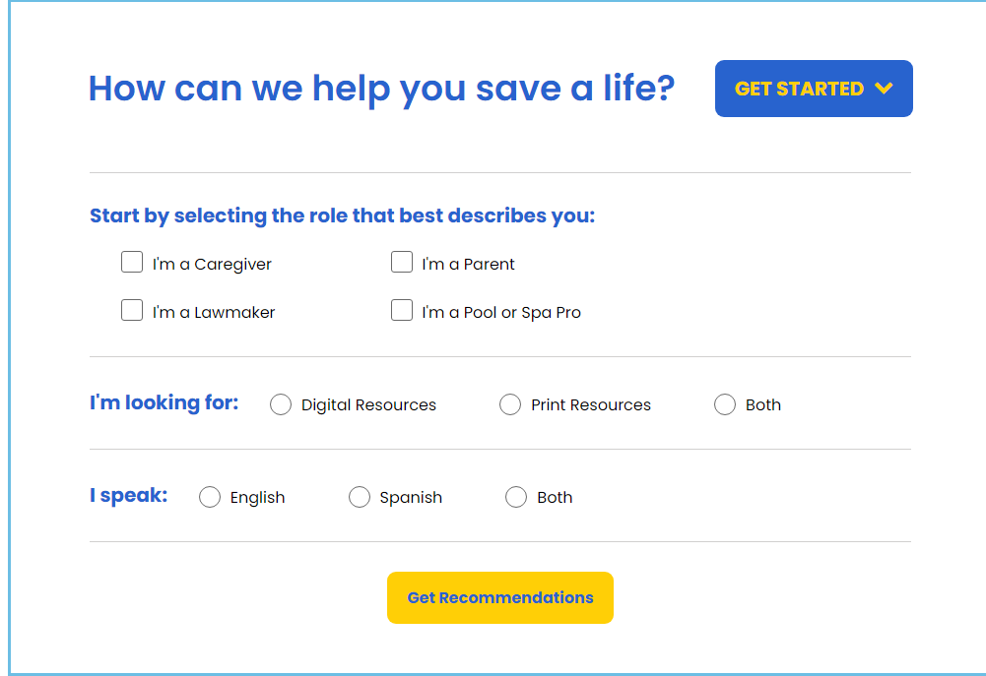
Safe Water Information Match (S.W.I.M.) Tool
To get a list of customized water safety materials tailored to you, click the link below:
https://www.poolsafely.gov/blog/how-can-we-help-you-save-a-life-introducing-the-new-s-w-i-m-tool/
RESOURCES |

Slide 31
Neighborhood Safety Network (NSN) Posters
To download posters with drowning prevention safety tips in English and Spanish, click the link below:
https://www.poolsafely.gov/educational-materials-catalog/?keyword=Neighborhood+Safety+Tip+Poster&sort=newest
RESOURCES |

Slide 32
Pool Safely Blog
Check out the Pool Safely blog! https://www.poolsafely.gov/blog/
You’ll get a behind-the-scenes look at the Pool Safely campaign, learn practical safety information, and stay up-to-date with the latest activities in the water safety community.
RESOURCES |

Slide 33
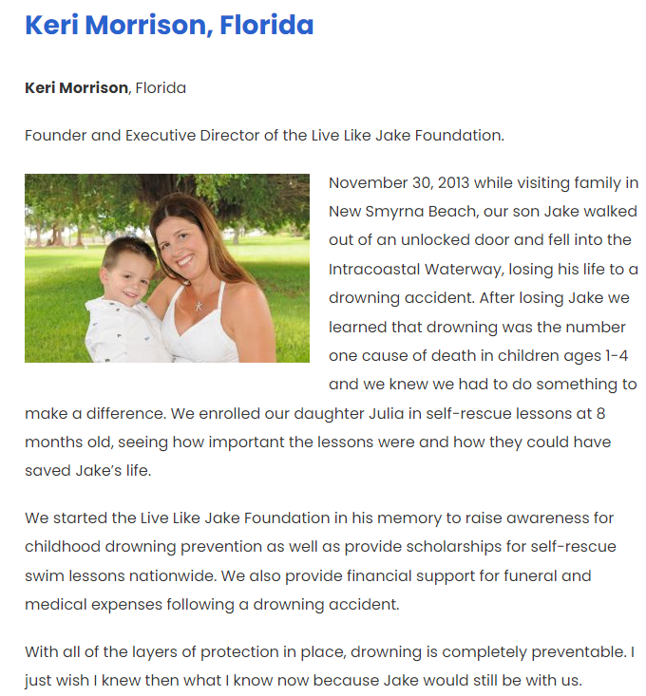
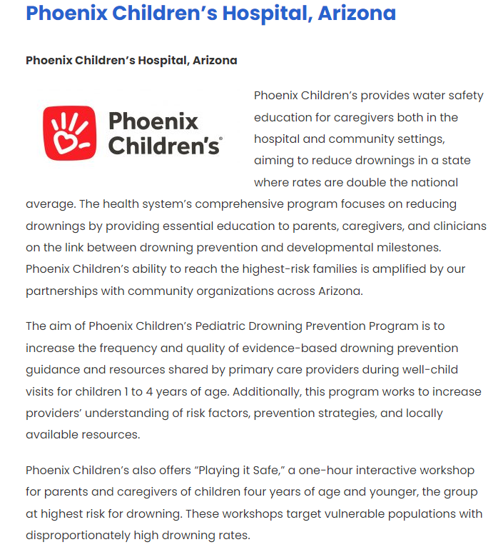
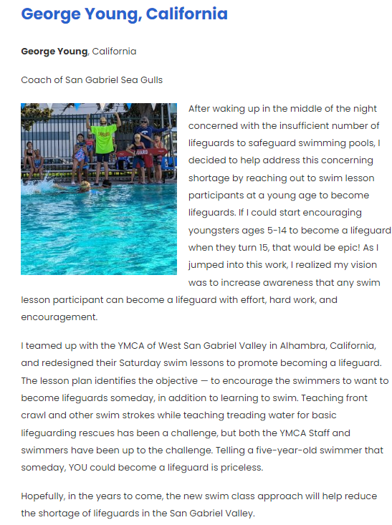
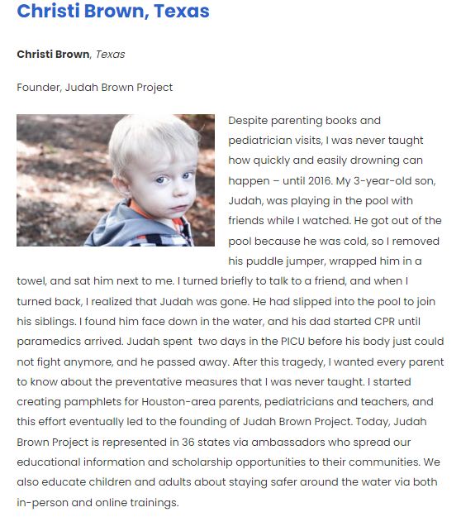
Pool Safely Stories
Pool Safely collaborators, campaign supporters, and water safety advocates share their experiences with childhood drowning and entrapment at: https://www.poolsafely.gov/pool-safely-stories/
Visit the link to read about their water safety journeys.
To submit a Pool Safely story, send an email to PoolSafely@FinnPartners.com.
RESOURCES |

Slide 34
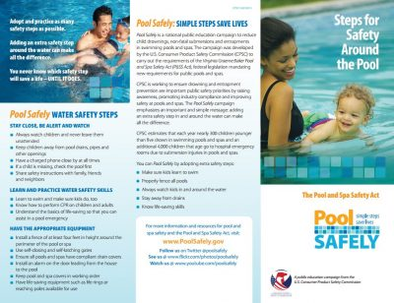
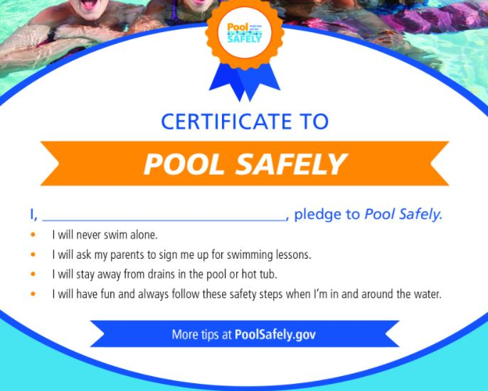
Materials Catalog
Download for brochures, tip cards, posters, videos, and more in English and Spanish through our online materials catalog, all for no charge:
https://www.poolsafely.gov/educational-materials-catalog/
https://www.poolsafely.gov/espanol/catalogo-de-materiales-educativos/
RESOURCES |

Slide 35
SECTION 08
Contact Information
|

Slide 36
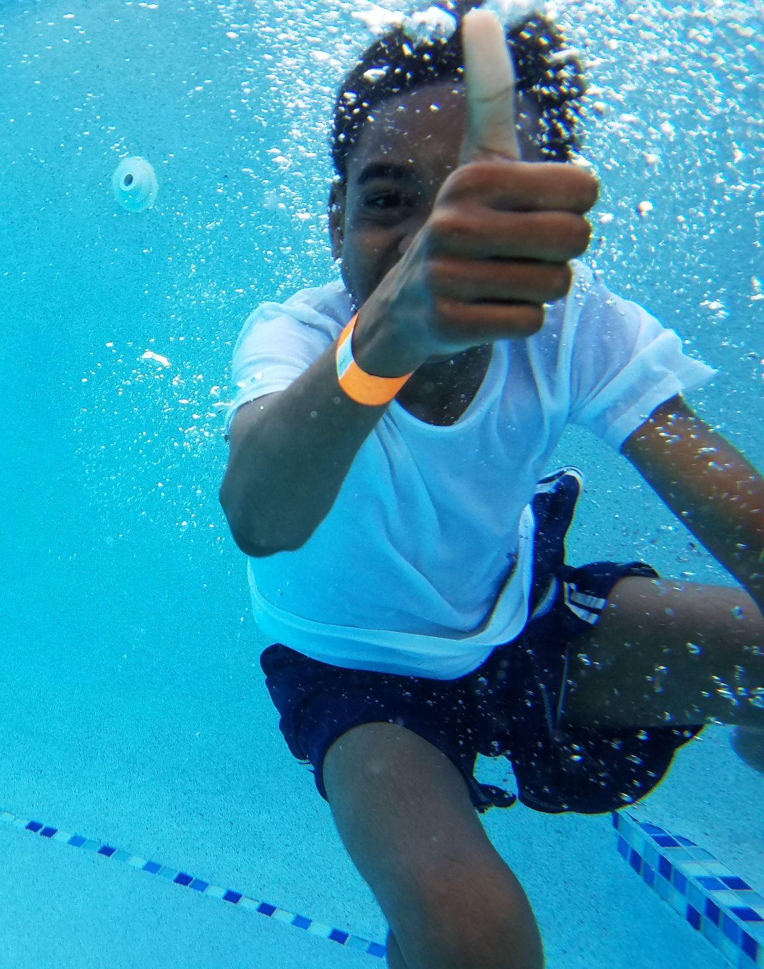
Keep in touch
with Pool Safely
To follow Pool Safely on Instagram: www.Instagram.com/poolsafely/
To follow Pool Safely on Threads: www.threads.net/@poolsafely
To follow Pool Safely on Facebook: www.facebook.com/poolsafely/
To follow Pool Safely on X:
www.twitter.com/poolsafely
To email us your questions, photos, and information about your water safety events: PoolSafely@FinnPartners.com
CATEGORIES, VISUALS, & USAGE |

